Slide 1
SOLID principles

Slide 2
Overview
The first five principles of Object Oriented Design (OOD)
Defined by Robert C. Martin in the early 2000s
Creating a system that is easy to maintain and extend over time

Slide 3
The principles
(S) SRP - Single Responsibility Principle
(O) OCP - Open/Closed Principle
(L) LSP - Liskov Substitution Principle
(I) ISP - Interface Segregation Principle
(D) DIP - Dependency Inversion Principle

Slide 4
Interface Segregation Principle

Slide 5
The common approach
Low-level module is used by many different high-level modules (clients), all of them having a specific way of working the low-level module.
This leads to problems:
Interface pollution - an interface is being polluted with methods that it doesn't require making it "fat“ and non-cohesive.
Degenerate method implementations in implementing classes.

Slide 6
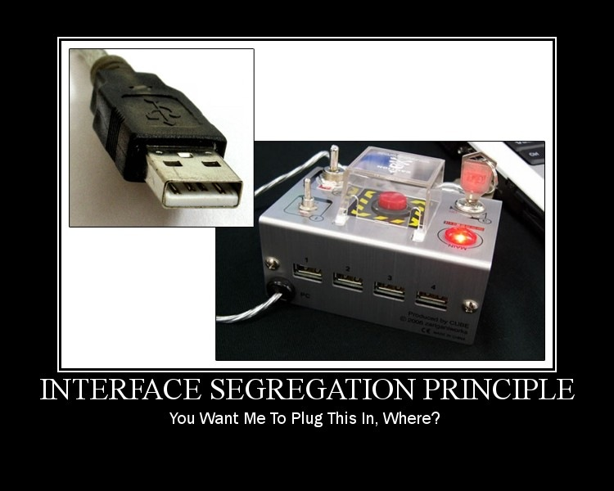
The problem illustrated

Slide 7
ISP defined
Clients should not be forced to depend on methods they do not use.

Slide 8
Example: Door

Slide 9
Exercise: Factory
Refactor the Factory application to be compliant with the interface segregation principle.

Slide 10
Single Responsibility Principle

Slide 11
The common approach
Classes tend to have many responsibilities. In a class that has more than one responsibility, the responsibilities become coupled. Changes to one responsibility may impair or inhibit the class's ability to meet the others. This kind of coupling leads to fragile designs that break in unexpected ways when changed.
A responsibility is defined as an axis of change. A class has multiple responsibilities if it has more than one reason for change.

Slide 12
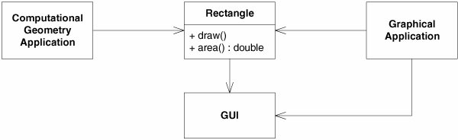
Example
Problems:
The GUI library needs to be included in the Computational Geometry Application.
Changes to the Graphical Application that require changes to the Rectangle class will force changes in the Computational Geometry Application as well forcing the application to be rebuilt, retested and redeployed.

Slide 13
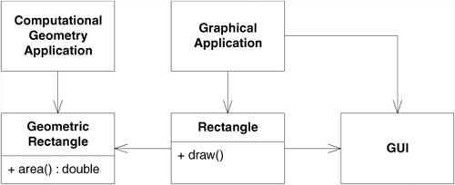
SRP defined
A class should have only one reason to change.

Slide 14
Example: Rectangle

Slide 15
Dependency Inversion Principle

Slide 16
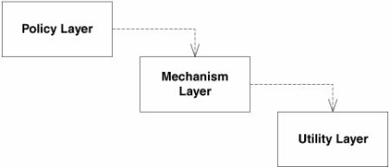
The common approach
Traditionally high-level modules have been dependent on low-level modules.
Examples:
User management module would depend on a DAO module that persists the user data in a relational database.
Checkout module would depend on a payment gateway such as PayPal.
The password management module would depend on a SMTP server for sending the "forgot password" email.

Slide 17
Hence the problems
Changes to low-level modules have direct effects on the high-level modules.
Change to the API of a low-level module would require changes in the code of a high-level module that depends on it.
The tight coupling between modules makes it very hard to replace low-level modules with alternatives. The same is problem when it comes to reusing high-level modules in different contexts.
Replacing the DAO module that stores the data in a relational database with one that stores it in a NoSQL database.
Replacing PayPal with Google Wallet.
Opting for an SMS "forgot password" notification rather than an email based one.

Slide 18
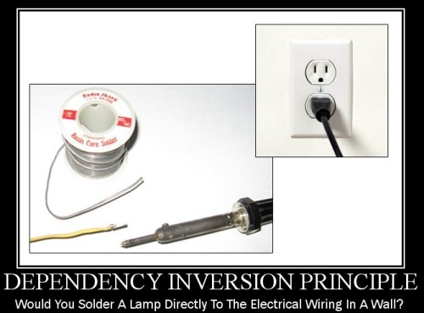
The problem illustrated

Slide 19
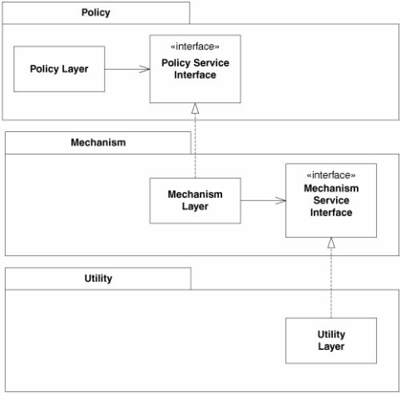
DIP defined
High-level modules should not depend on low-level modules. Both should depend on abstractions.
Abstractions should not depend upon details. Details should depend upon abstractions.

Slide 20
Example: ElectricalSystem

Slide 21
Exercises

Slide 22
Exercise: MotionDetector
Create a motion detector component that sends an alarm to a list of subscribed alarm channels in case it detects changes between two subsequent images it requests from an image capturing device.
For testing/simulation purposes:
Create an image capturing device that reads from the console (System.in) and alarm channel that writes to the console (System.out).
Once started, the motion detector should run until the image capturing device returns an empty image (null).
Group classes and interfaces of components in distinct packages.

Slide 23
Exercise: WaterHeater
A large industry manufacturer Ventoelectrics has asked your company ACME to provide two thermoregulatory components, standard and efficient, that they intent to use in their water heater production line. They have their own production of the other components such as the power switch, heater and thermometer.
The standard thermoregulator should take an input reading from the thermometer every 3 seconds while the efficient should do that every 1 second. Both enable and disable the heater in respect to the following rules:
The heater gets disabled if the temperature raises above a configured value.
The heater gets enabled if the temperature drops below a configured value.
Group component classes and interfaces in distinct packages.
Make sure you’re able to offer your thermometer product line to other vendors in the future.

